Slide 1

Data Types &
Expressions:
By: Mir Faraz Ali
Programming Fundamentals

Slide 2
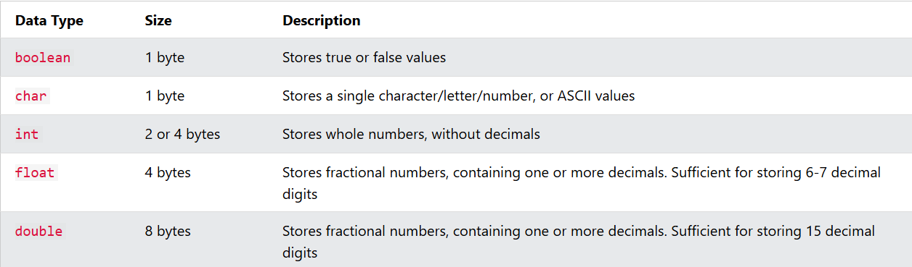
Basic Data Types:
The data type specifies the size and type of information the variable will store:

Slide 3
C++ Numeric Data Types
  Numeric Types:
  Int:
int myNum = 1000;
cout << myNum;
  Use int when you need to store a whole number without decimals, like 35 or 1000, and float or double when you need a floating point number (with decimals), like 9.99 or 3.14515.
  Float:
float myNum = 5.75;
cout << myNum;
  Double:
double myNum = 19.99;
cout << myNum;

Slide 4
C++ Boolean Data Types
  Boolean Types:
  Example:
  A boolean data type is declared with the bool keyword and can only take the values true or false.
  When the value is returned, true = 1 and false = 0.
bool isCodingFun = true;
bool isFishTasty = false;
cout << isCodingFun; // Outputs 1 (true)
cout << isFishTasty; // Outputs 0 (false)

Slide 5
C++ Character Data Types
  Character Types:
  Example:
  The char data type is used to store a single character. The character must be surrounded by single quotes, like 'A' or 'c':
  Alternatively, if you are familiar with ASCII, you can use ASCII values to display certain characters:
char myGrade = 'B';
cout << myGrade;
  Example:
  char a = 65, b = 66, c = 67;
  cout << a;
  cout << b;
  cout << c;

Slide 6
C++ String Data Types
  String Types:
  Example:
  The string type is used to store a sequence of characters (text). This is not a built-in type, but it behaves like one in its most basic usage.
  String values must be surrounded by double quotes:
  To use strings, you must include an additional header file in the source code, the <string> library:
string greeting = "Hello";
cout << greeting;
  Example:
  // Include the string library
  #include <string>
  // Create a string variable
  string greeting = "Hello";
  // Output string value
  cout << greeting;

Slide 7
Real life Example:
// Create variables of different data types
int items = 50;
double cost_per_item = 9.99;
double total_cost = items * cost_per_item;
char currency = '$';
// Print variables
cout << "Number of items: " << items << "\n";
cout << "Cost per item: " << cost_per_item << currency << "\n";
cout << "Total cost = " << total_cost << currency << "\n";

Slide 8
C++ Operators
  C++ Operators:
  Operators are used to perform operations on variables and values.
  In the example below, we use the + operator to add together two values:
  Example:
int x = 100 + 50;
int sum1 = 100 + 50; // 150 (100 + 50)
int sum2 = sum1 + 250; // 400 (150 + 250)
int sum3 = sum2 + sum2; // 800 (400 + 400)
  Although the + operator is often used to add together two values, like in the example above, it can also be used to add together a variable and a value, or a variable and another variable:

Slide 9
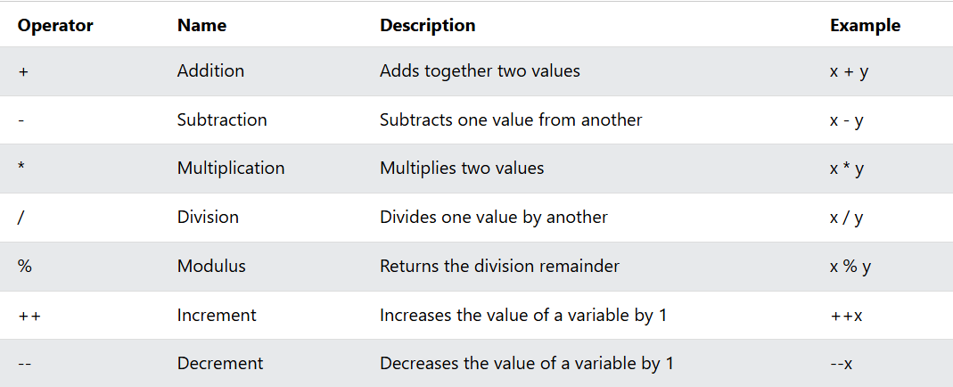
Arithmetic Operators
  Arithmetic operators are used to perform common mathematical operations.

Slide 10
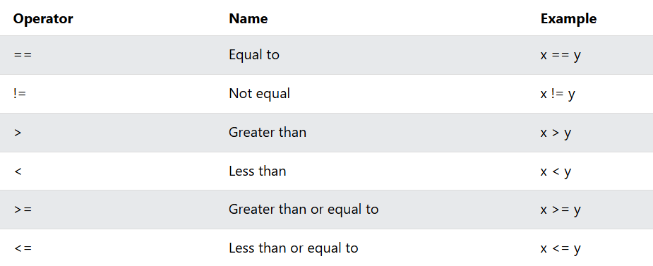
C++ Comparison Operators
  A list of all comparison operators:

Slide 11
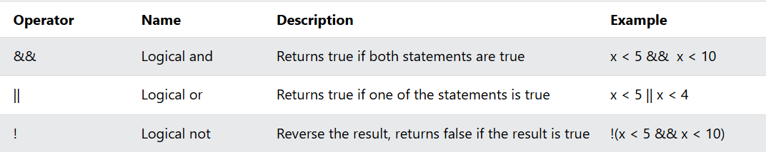
C++ Logical Operators
  As with comparison operators, you can also test for true (1) or false (0) values with logical operators.
  Logical operators are used to determine the logic between variables or values:

Slide 12

End Of Class

